Slide 1
Pre-boot eXecution Environment
Aya Allah Ali
Aya Shaaban
Osama Ahmed Amin

Slide 2
What is PXE?
PXE stands for pre-boot execution environment.
PXE is a key part of data center infrastructure because it enables automated provisioning of servers or work stations over a network.
Installing operating systems from CDROM was painfully slow and we desired an automated solution.

Slide 3
Conclusion of the main idea
PXE works with Network Interface Card (NIC) of the system by making it function like a boot device.
The PXE-enabled NIC of the client sends out a broadcast request to DHCP server
DHCP server returns with the IP address of the client along with the address of the TFTP server, and the location of boot files on the TFTP server

Slide 4
How it Works
01
03
Target Machine is booted.
DHCP server responds with standard information
(IP, subnet mask, gateway, DNS etc..)
In addition, it provides information about the location of a TFTP server and boot image (pxelinux.0).
02
The Network Interface Card (NIC) of the machine triggers a DHCP request

Slide 5
How it Works
04
06
When the client receives this information, it contacts the TFTP server for obtaining the boot image.
By default, the boot image searches the pxelinux.cfg directory on TFTP server for boot configuration files on the TFTP server
05
07
TFTP server sends the boot image (pxelinux.0), and the client executes it.
The client downloads all the files it needs (kernel and root file system), and then loads them.

Slide 6
How it Works
08 Finally
Target Machine reboots.
The Provisioning application uses Redhat's Kickstart method to automate the installation of Redhat Linux on target machines. Using kickstart, the system administrator can create a single file containing answers to all the questions that will usually be asked during a typical Red Hat Linux installation
The host specific boot configuration file contains the location of the kickstart file. This kickstart file would have been created earlier by the stage directive of the OS image based on the input from user.

Slide 7
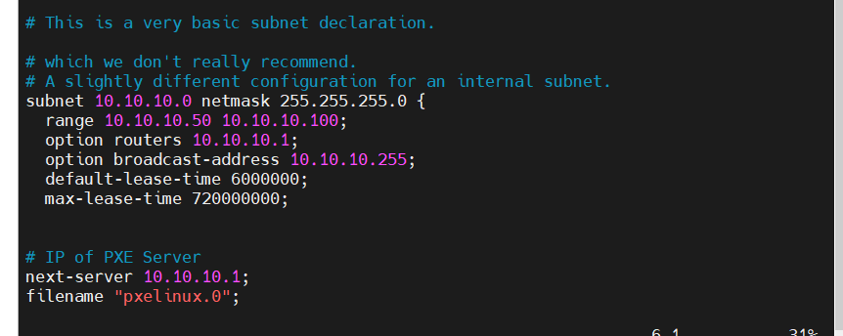
Configuration
Configure DHCP Server for PXE
vim /etc/dhcp/dhcpd.conf

Slide 8
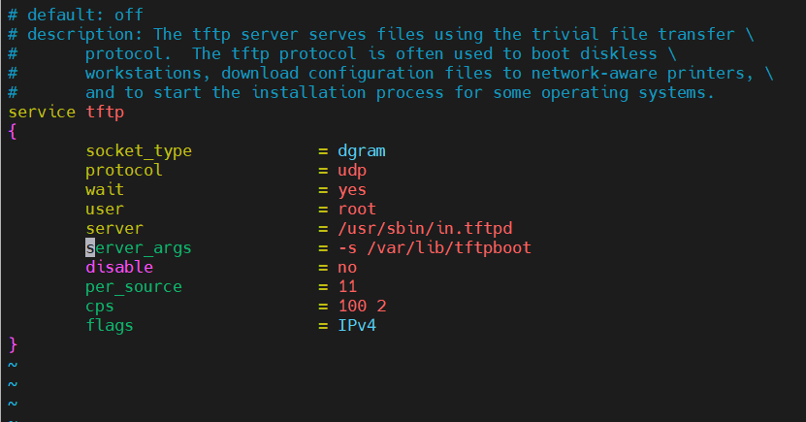
Configuration
TFTP (Trivial File Transfer Protocol ) is used to transfer files from data server to its clients without any kind of authentication.
Edit and Config tftp server
Vim /etc/xinetd.d/tftp

Slide 9
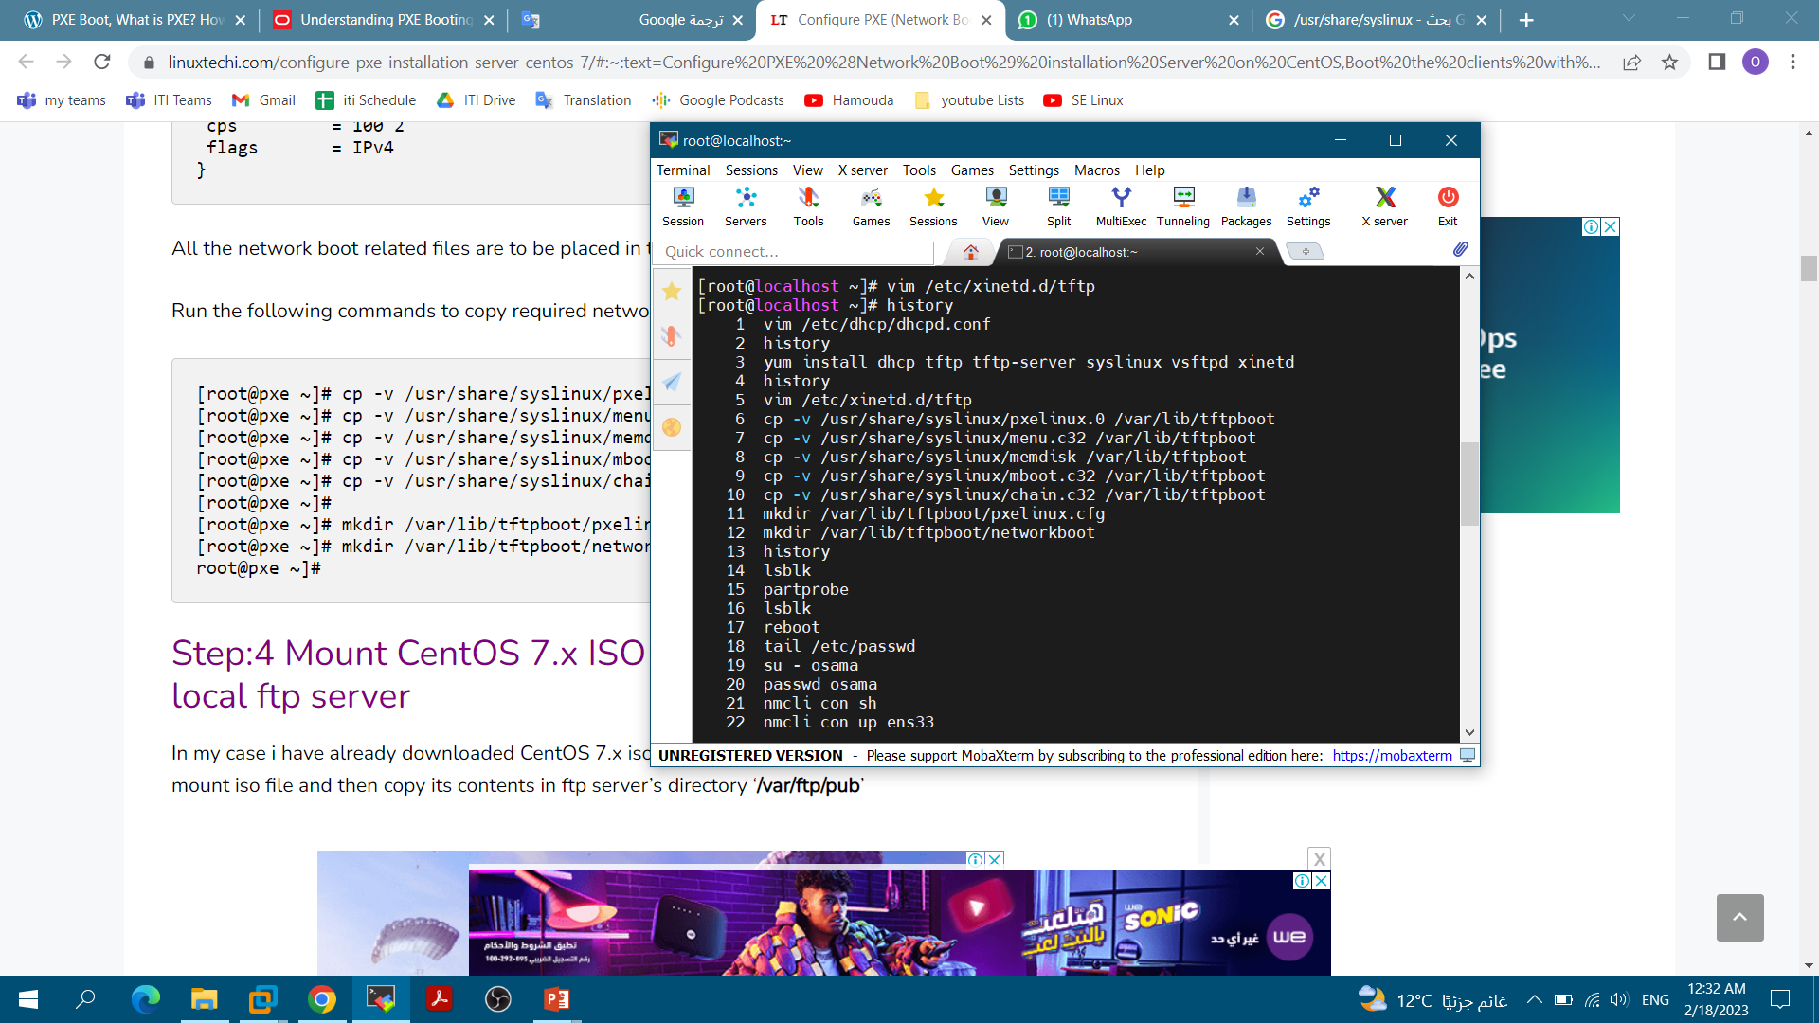
Configuration
All the network boot related files are to be placed in tftp root directory “/var/lib/tftpboot”
/Networkboot/ to cp kernel file and init file there

Slide 10
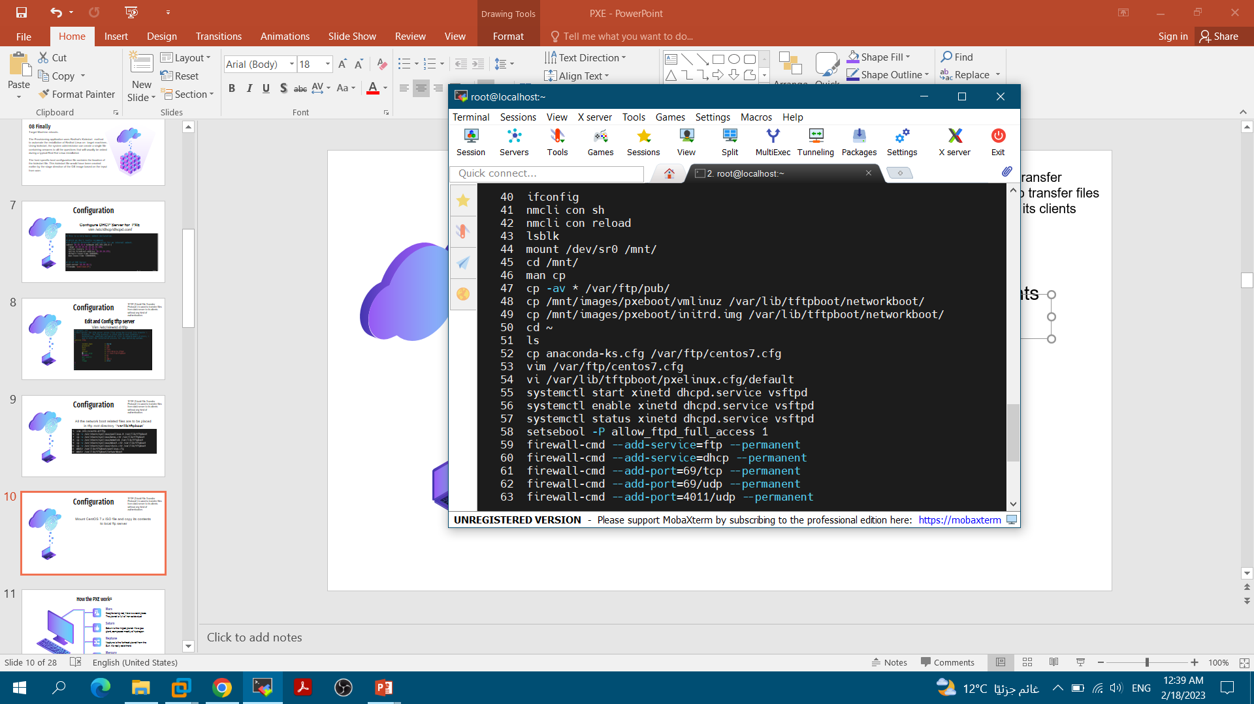
Configuration
1. Mount CentOS 7.x ISO file and copy its contents to local ftp server /var/ftp/pub/
2. Copy Kernel file (vmlimz) and initrd file from mounted iso file to ‘/var/lib/tftpboot/networkboot/

Slide 11
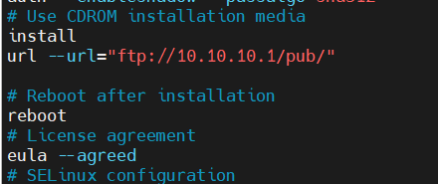
Configuration
We will create a new kickstart under the folder /var/ftp/pub with the name ‘centos7.cfg’/
cp /root/anaconda-ks.cfg /var/ftp/centos7.cfg
vim /var/ftp/centos7.cfg

Slide 12
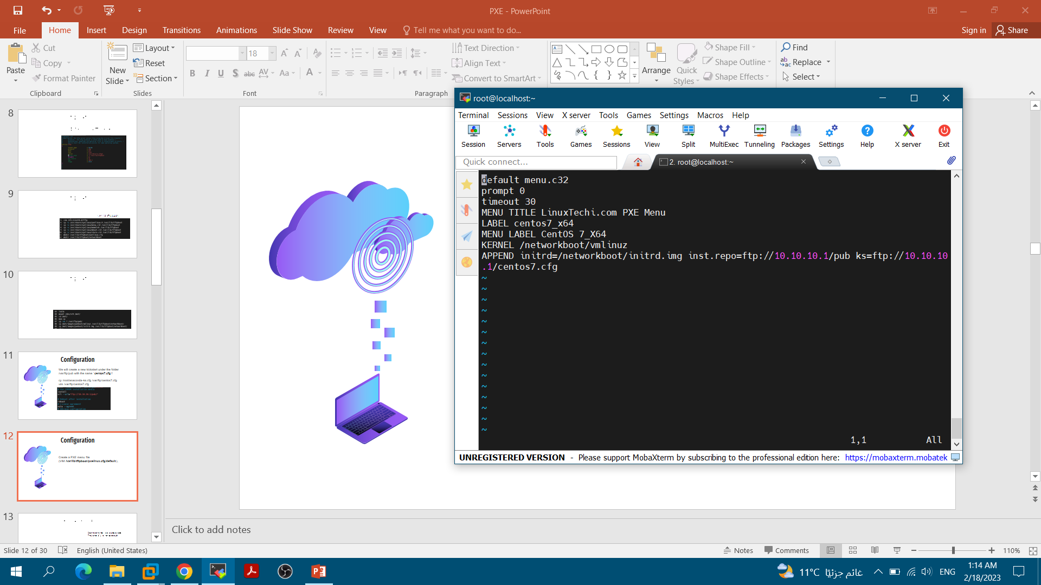
Configuration
Create a PXE menu file
(VIM /var/lib/tftpboot/pxelinux.cfg/default),

Slide 13
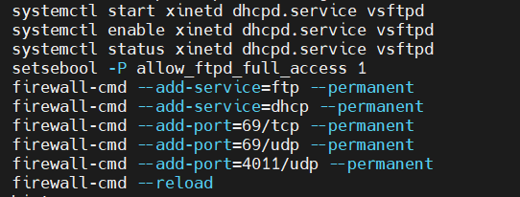
Configuration
Start and enable xinetd, dhcp and vsftpd service
Open the ports in the OS firewall
selinux rule for ftp server.

Slide 14
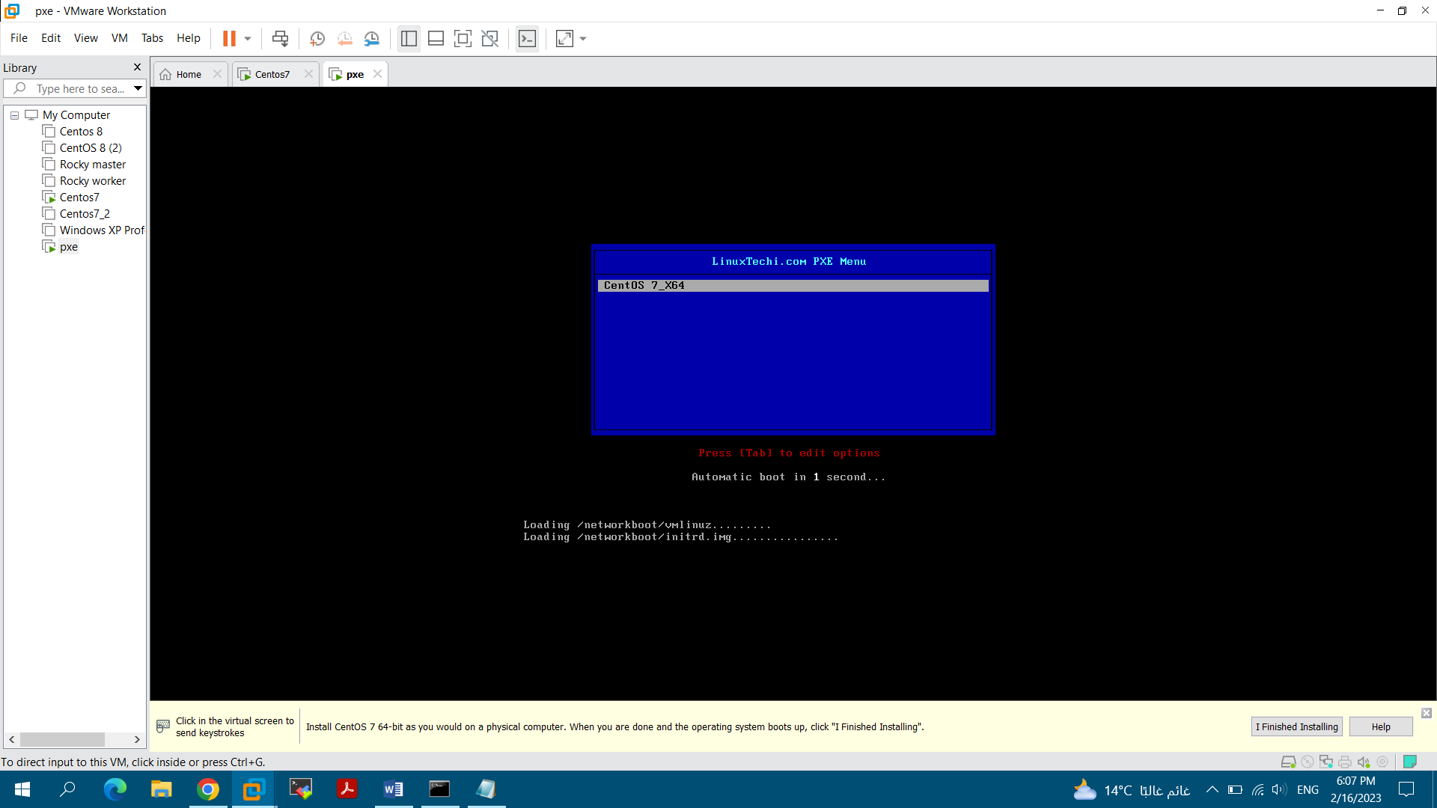
Configuration
Boot the client with pxe boot option (Menu)

Slide 15
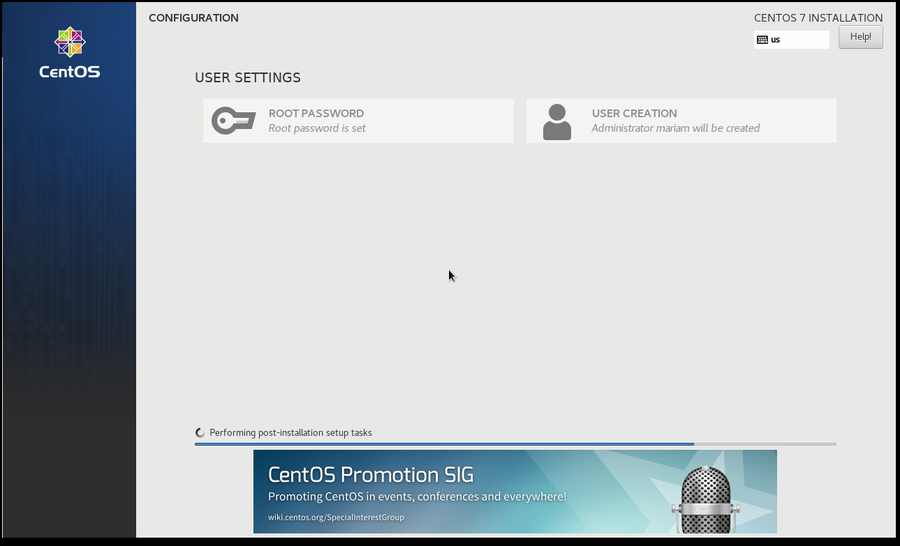
Configuration
Boot the client with pxe boot option (installation)

Slide 16
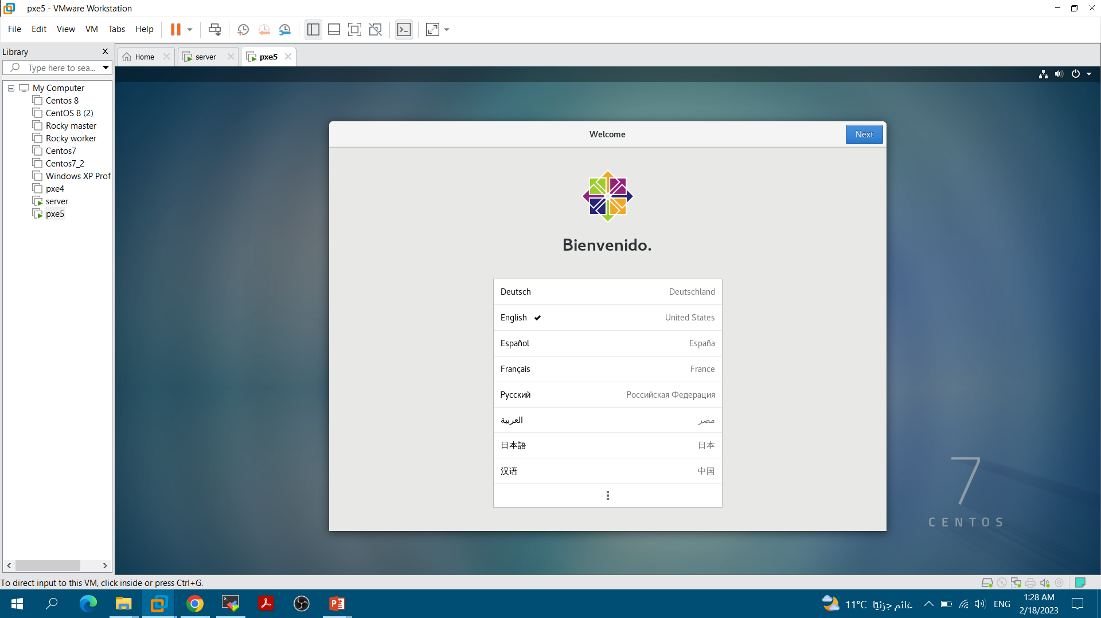
Final Output

Slide 17
PXE vs. IPXE
IPXE
PXE
It mainly uses the tftp protocol for file transfer
Transfer speeds are low and things generally don’t work too well over high latency and/or low bandwidth links due to the content size required in today’s environment.
iPXE is the leading Open Source network boot firmware, which offers a small footprint (75KB for BIOS and about 128KB for EFI) boot loader, which allows the system to switch to a better suited protocol for high speed/high latency/high packet loss environments.
iPXE also offers you the ability to boot
From: web server, iscsi SAN, wireless network and cloud

Slide 18
Thank You
Aya Allah Ali
Aya Shaaban
Osama Ahmed Amin

